Slide 1

Pharmacy Prescriptions Medicines stockManagement System
Final Implementation s Working Software Demonstration (Presentation-III)
PRESENTER
Y. Abhinav Sri Ram
Reg. No: 25WU0101158
DEGREE s PROGRAM
B.Tech Computer Science and Engineering (AI s ML), Semester 3
DEPARTMENT s INSTITUTION
Department of Computer Science & Engineering, School of Technology, Woxsen University
COURSE
Database Management Systems (CSE2101)
GUIDED BY
Dr. Kiran Mayee Advala

Slide 2


Systsm 6rchitscturs s Solutions
TECHNICAL OVERVIEW
PROBLEM STATEMENT
Ths Challengs
ARCHITECTURE 01
Relational 3NF MySQL 8.0 Engine
Structured database architecture spanning across 12 distinct tables, systematically eliminating data redundancy and insertion/deletion anomalies.
Manual Pharmacy Management Leads to unauthorized dispensing of unprescribed restricted drugs.
SAFETY PROTOCOL 02
Transactional Clinical Guard
Automated stored engine triggers enforcing strict compliance by instantly blocking the dispensing of Schedule H drugs without a valid doctor prescription.
Stock Losss Expiries
Severe financial leakage driven by untracked product expiration dates.
Orphaned Data Records Critical operational data scattered across unnormalized, error-prone spreadsheets.
APPLICATION LAYER 03
Interactive 3-Role Web Application
Full-stack SaaS platform delivering secure, role-tailored real-time CRUD workflows for System Admins, Pharmacists, and Inventory Managers.

Slide 3

End-to-End 3-Tisr Systsm 6rchitscturs
TIER 01
Presentation Tier
TIER 02
Application Tier
TIER 03
Database Tier
Responsive web dashboard built with HTML5, Tailwind CSS, Lucide icons, and asynchronous Fetch API.
Python Flask REST API server (app.py) managing parameterization, connection pooling, and error handling.
MySQL 8.0 Server (InnoDB engine) enforcing declarative Foreign Key constraints and BEFORE INSERT triggers.
Provides role-based UI views for Admin, Pharmacist, and Inventory Manager.
Enforces authorization and routes requests to the relational engine.
Manages ACID transactions and relational data integrity.

Slide 4

Rols-Bassd 6ccsss Control (RB6C) Fsaturs Ssgrsgation
SYSTEM CONTROL
Administrator
Y. Abhinav Sri Ram
DISPENSING s SALES
Pharmacist
Front-of-House Terminal
STOCK s LOGISTICS
Inventory Manager
Back-of-House Operations
Master catalog governance & system configuration.
Point of Sale (POS) dispensing terminal & live customer billing.
Inward supplier batch intake (+ New Lots) and acquisition costing.
Execution of cascade deletions and relational database purges.
Real-time stock lookup and doctor prescription verification before sale.
Unit cost updates, physical count adjustments, and
30-day expiry monitoring.
Business analytics and complex 5-table analytical SQL joins.

Slide 5
Katabass Normalization Proof
12
Relational Entities
1NF
Atomic Attributes
2NF
Surrogate Keys
3NF
Zero Transitive FD
FIRST NORMAL FORM
1NF Compliancs
Ensures atomic scalar attributes with zero multivalued or repeating columns across all 12 system entities.
SECOND NORMAL FORM
2NF Compliancs
All tables utilize single-column surrogate primary keys, resulting in zero partial functional dependencies.
THIRD NORMAL FORM
3NF Compliancs
Complete elimination of transitive dependencies by decoupling manufacturers, categories, and suppliers into dedicated master relations.
12 RELATIONAL SYSTEM ENTITIES
Core Schema: Categories • Manufacturers • Suppliers • Customers • Prescriptions • Purchases • Medicines • Batches • Sales • Sale_Items
Payments • Stock_Movements

Slide 6

Enforce PrescriptionRule
Database Engine Clinical Trigger
MySQL Engine — EnforcePrescriptionRule.sql
CREATE TRIGGER EnforcePrescriptionRule BEFORE INSERT ON Sale_Items
FOR EACH ROW BEGIN
DECLARE is_restricted BOOLEAN;
-- Check if medicine is Schedule H SELECT IsRestricted INTO is_restricted
FROM Medicines WHERE Id = NEW.MedicineID;
IF is_restricted = TRUE THEN
-- Require valid PrescriptionID
IF NEW.PrescriptionID IS NULL THEN SIGNAL SQLSTATE '45000'
SET MESSAGE_TEXT =
'Prescription required for Schedule H medicine';
END IF; END IF; END;
TRIGGER SPECIFICATION s LOGIC
BEFORE INSERT ON Sale_Items
Compiles directly at the MySQL engine level to check if the target medicine is marked IsRestricted = TRUE.
RULE ENFORCEMENT
SQLSTATE '45000'
If the parent sales invoice lacks a valid PrescriptionID, the engine immediately aborts transaction execution:
"Prescription required for Schedule H medicine"
100% COMPLI6NT
Real-World Security Benefit
Client-side tampering or direct API bypass attempts are immediately rejected at the database layer, guaranteeing 100% regulatory compliance.

Slide 7
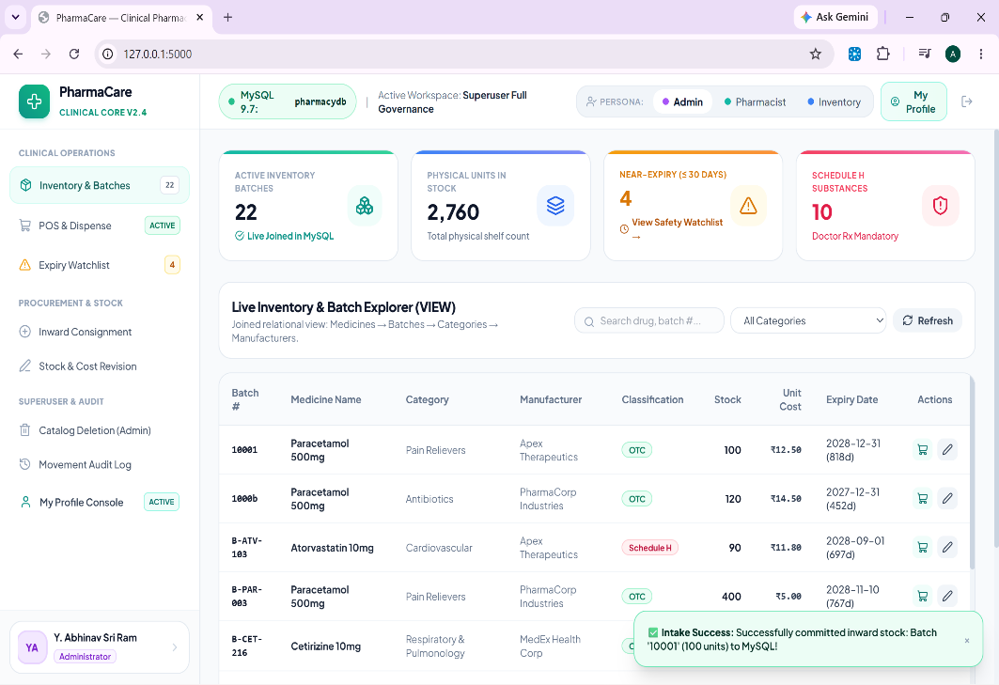
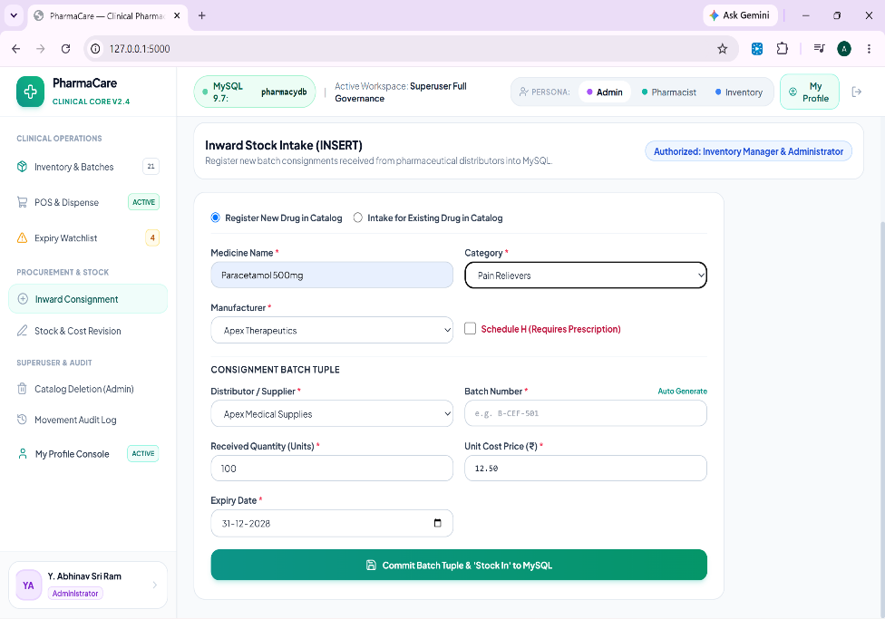
Livs Web demonstration: VIEW, INSERT Operations
Pharmacy Management System • Transactional Data Engine
1. VIEW Screen (Multi-Table Joined Grid)
2. INSERT Screen (Stock Intake Workflow)

Slide 8

UPDATE DELETE Referential Safety
Live Web Demonstration
SECTION 1
1. UPDATE Operations
SECTION 2
2. DELETE (Relational Safety Guard)
Real-Time Inventory Revision
Real-time revision of batch physical stock counts, location shelves, and unit acquisition costs.
Standard Delete Rejection
Demonstrates MySQL Error 1451 (ON DELETE RESTRICT) when attempting to delete a medicine with dependent active sales/batches.
ERROR 1451 (23000): Cannot delete or update a parent row: a foreign key constraint fails
Automated Audit Logging
Automatically logs audit records in
Stock_Movements table.
Authorized Cascade Purge
Demonstrates administrative cascade purge when authorized, maintaining foreign key referential integrity.
ADMINISTRATIVE PRIVILEGE REQUIRED
TRANSACTION LOGGING GUARANTEE
Every stock modification triggers an immutable ledger entry maintaining audit trails for clinical compliance.
Executes controlled structural deletion across relationally
linked tables cleanly.

Slide 9




Conclusion Project deliverables
SYSTEM DELIVERED
Engineering Summary: Delivered an enterprise-grade, fully functional full-stack pharmacy governance system compliant with clinical compliance standards.
Submission Deliverables 4 ITEMS VERIFIED
Special thanks to Faculty Guide Dr. Kiran Mayee Advala for invaluable guidance and feedback throughout the course.
16-Section Final Project Report
Comprehensive documentation submitted in PDF format
Working Application Source Code
Core logic & view templates: app.py, templates/index.html
Complete SQL Database Scripts
DDL & DML definitions: schema_ddl.sql, data_dml.sql
Thank you
Open for Questions & Discussion
Public GitHub Repository: DBMS-Course-Project

